Slide 1
Data Citation, Licensing, & Attribution
[ and ]
Data Cleaning

Slide 2
Report out: Deposit Policy
Roadmap (some of you have a lot of planning + work to do)
Activity: Data Cleaning with Open Refine
Lecture: Data Citation (mostly academic settings)
Discussion: Licensing + Attribution
Activity: Curated datasets…

Slide 3
Data munging - messing around with data. (e.g. editing, normalizing, summary statistics, basic visualizations)

Slide 4
Data cleaning is the practice of preparing data for analysis. Depending on the analysis, this can take many different forms. But all data cleaning includes two steps:
Finding missing, incomplete, incorrect, or irrelevant information
Correcting it.

Slide 5
Excel is helpful for basic data munging (editing, normalizing, basic summarizations) at a small scale.
But hard to do systematic and replicable operations for data cleaning
Command line tools (programming languages in a Unix terminal) are very good for advanced data cleaning
But difficult to do data munging necessary for basic, everyday work with tabular data.

Slide 6

Open Refine is a compromise between a GUI and a Database. It gives you the power of data cleaning using advanced programming techniques, but allows you to do the same kind of data munging as Excel

Slide 7
Behaves like a database…?
Tables ‘view’
Actions are performed on Rows and Columns
Individual cells are editable.
No formulas stored in cells.
Operations are logged, and repeatable (!)
Facets
Summarizes data into sortable tables

Slide 8
Data types (not roles)
Text
Number
Boolean
Date

Slide 9
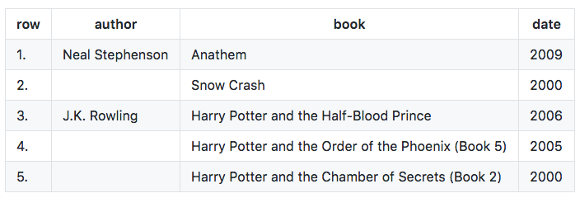
Rows vs records
Rows (quite literally) individual lines identifying unique objects
Records - rows that can be grouped together by a common value (useful for performing targeted data cleaning)

Slide 10
GREL
Google Refine Expression Language
Allows for more complex operations
functionName(arg0, arg1, …)
split("fire, water, earth, air", ",") returns the array of 4 strings: "fire", " water", " earth" , and " air”
arg0.functionName(arg1, …)
“food".startsWith("foo") - returns all food values that start with “foo”

Slide 11
Thats the basics!

Slide 12
I. Open Refine Basics
Creating a New Project
Basic Normalization
Faceting and Clustering
Records vs. Rows
Advanced Transformations
Notes:
-- Note that it runs on desktop but opens in browser.
-- Demonstrate how to create a new project; how to do basic normalization; how to facet and cluster
-- Hands on exercise for 15 minutes (if there are advanced users, start a break-out discussion group)

Slide 13
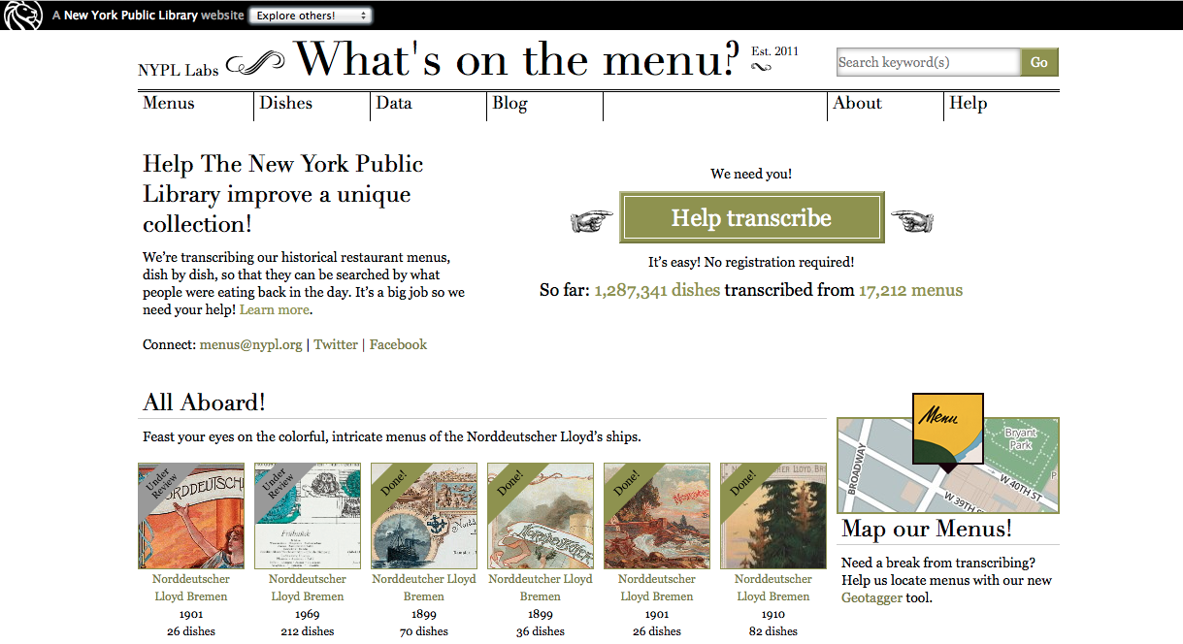
http://menus.nypl.org/
Notes:
-- NYPL has some 45,000 menus from 1840-present
-- Crowdsource project launched in April 2009
-- Creating a database of dishes

Slide 14


Crowdsourced transcription
Volunteer transcription can mean inconsistent data entry.
Even well-transcribed data needs cleaning (synonyms and spelling variants, etc.)
Changes over time:
vs.

Slide 15
Activity – get to know your data
Step 1: NYPL menus data
In our class Github repository, find ‘DATA’ find “Menus.csv”
Open in Excel or Notepad
Step 2: Discuss – what’s inconsistent with this data? What could be standardized?

Slide 16
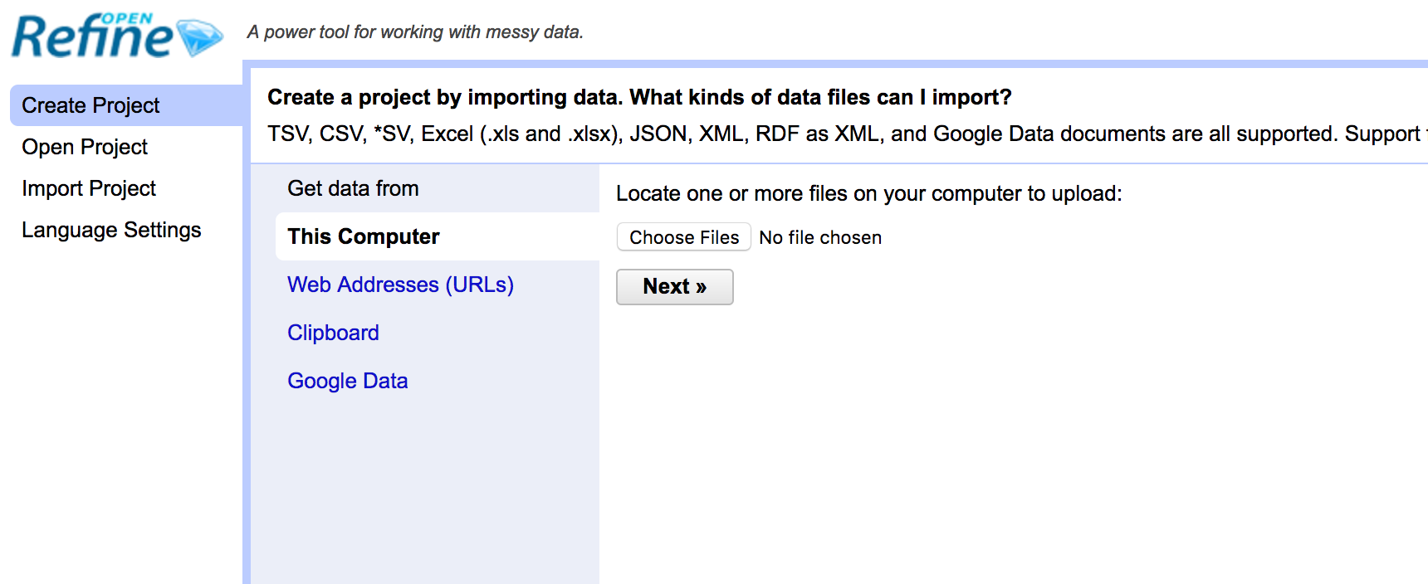
Creating a Project
Notes:
-- Choose create project (notice that you can also open projects you’ve worked on previously or import projects. The import feature is especially useful for collaboration)
-- Upload “Menu.csv”. Caveat: the other files are very large. It’s possible to allocate additional memory to Open Refine when working with large datasets, but not for the purposes of this demo. If this is important to you, we can discuss it during the hands-on session.

Slide 17
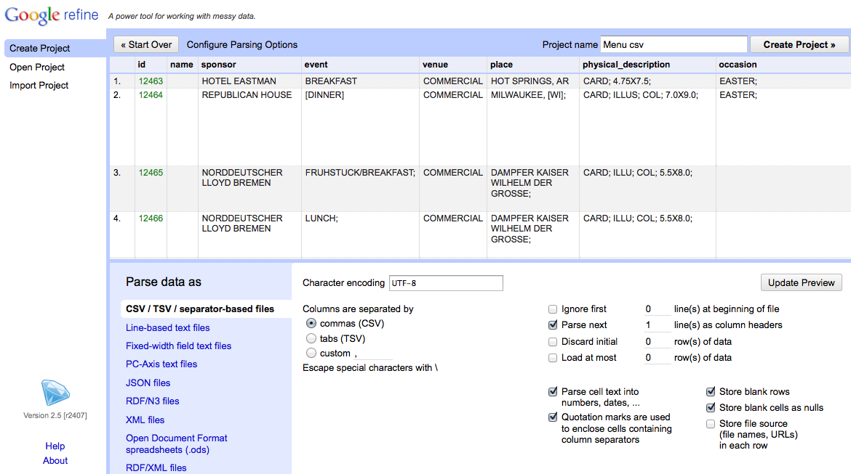
Creating a Project
Notes:
-- Use the preview window to review the data
-- Notice the parse options
-- for this data set, be sure that character encoding is UTF-8, Columns are set as CSV, and first line is parsed as a header
-- note quotation marks option. In this case, we have it checked, but it you use quotations in your data set for other purposes it may cause parsing issues
-- When you selected among options, click “update preview”, review again, and if all looks well, choose a project name and click “create project”

Slide 18
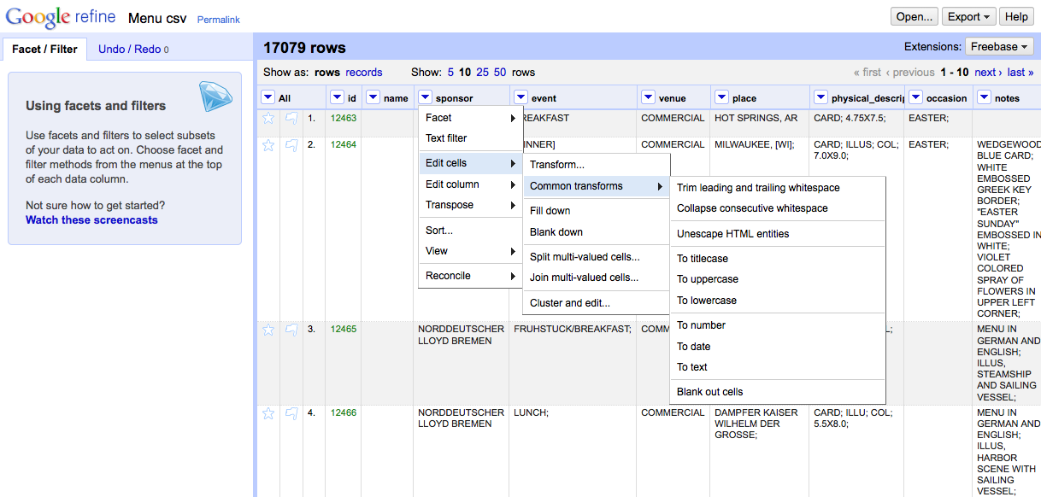
Basic Normalization
Notes:
-- click the arrow to the left of sponsor for a drop-down menu (notice the option your menu options)
-- choose edit cells
-- choose common transforms
-- start by trimming whitespace (you’ll notice that 14 cells were effected)
-- collapsing whitespace effects another 126 cells. Computers are better than humans at detecting white space.
-- also play with uniformly setting the cases

Slide 19
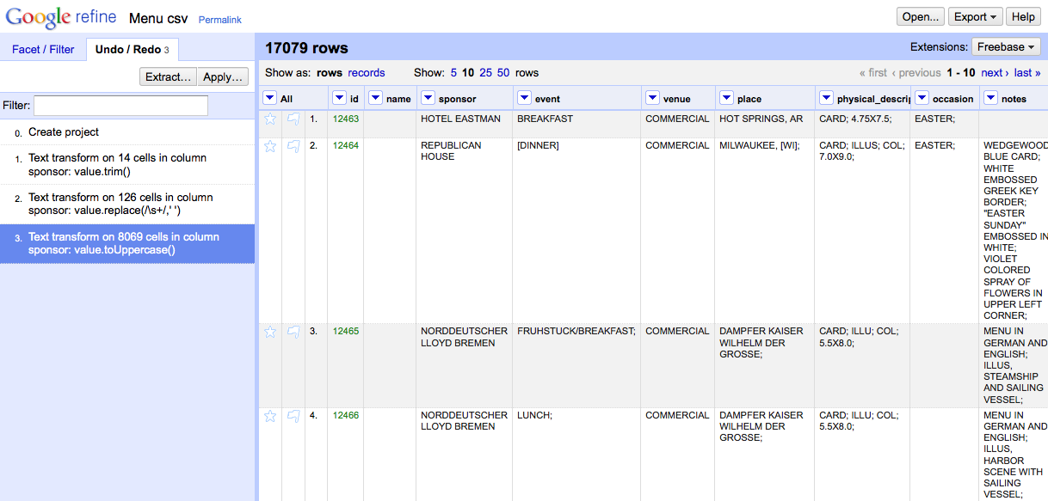
Tracking Project History
Don’t be afraid to make mistakes!
Notes:
Caveat: if you choose to navigate backward in your project history, you won’t be able to access any steps you’d taken after that point once you’ve made another change.

Slide 20
Extract and Apply!
Notes:
Note that you can extract your steps! This can save huge amounts of time for repetitive tasks

Slide 21
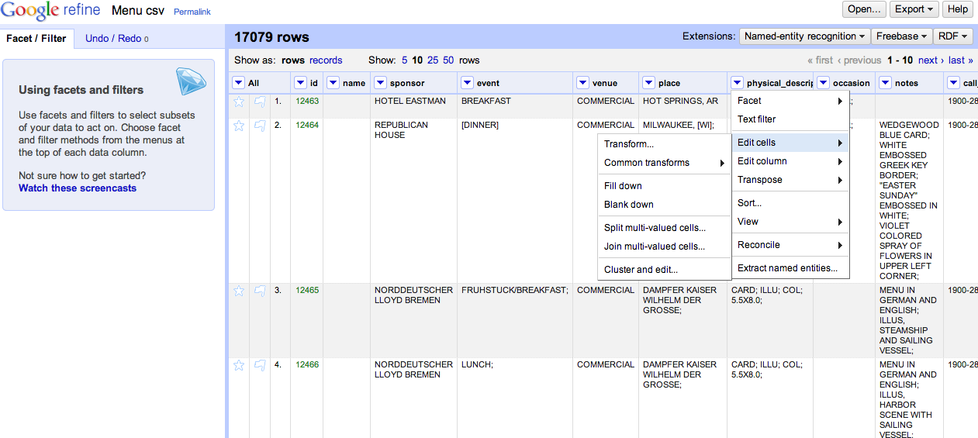
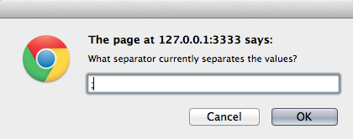
Records vs. Rows
Notes:
-- this likely won’t be needed today, but FYI: review the different between records and rows, beginning by splitting some multi-valued cells

Slide 22
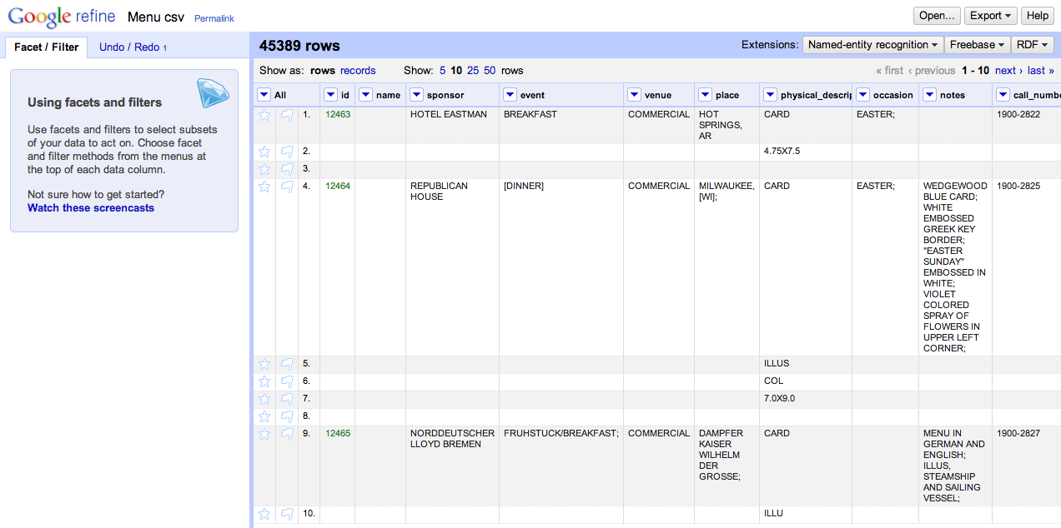
Multiple Values, Multiple Rows
Notes:
This is good if you’re only interested in specific values from the physical description, like whether or not menus are illustrated.
BUT, notice how the rest of rows 5, 6, and 7 are blank

Slide 23
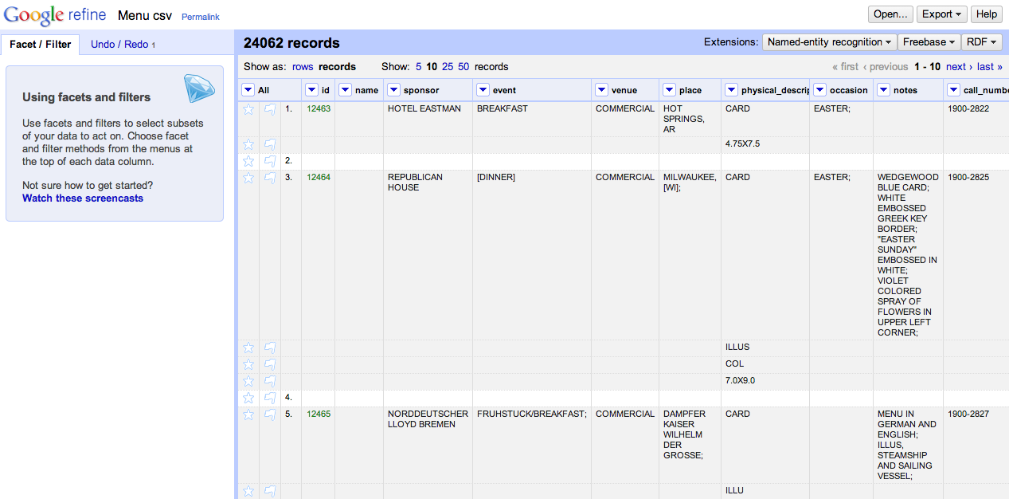
One Record, Multiple Rows
Notes:
Switching to the records view gives you the flexibility of gathering multiple rows together under the same ID.

Slide 24
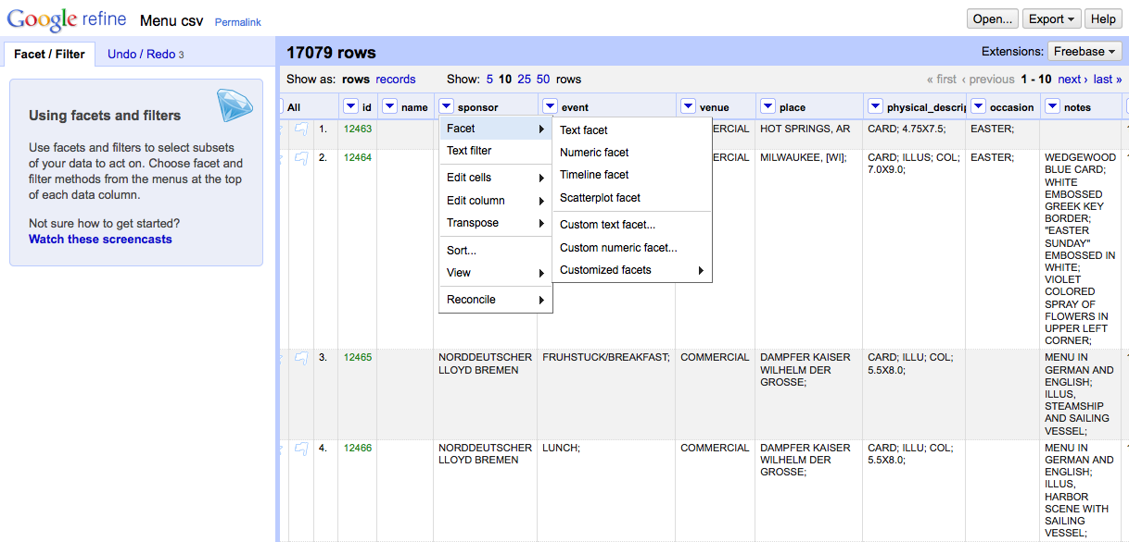
Faceting and Clustering
Notes:
-- Navigation to “Facet → Text facet”

Slide 25
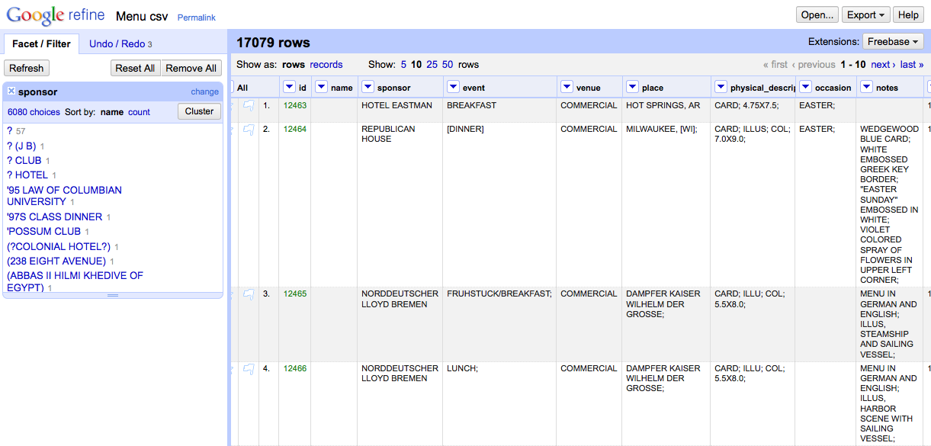
Faceting and Clustering
Notes:
-- Click “Cluster”

Slide 26
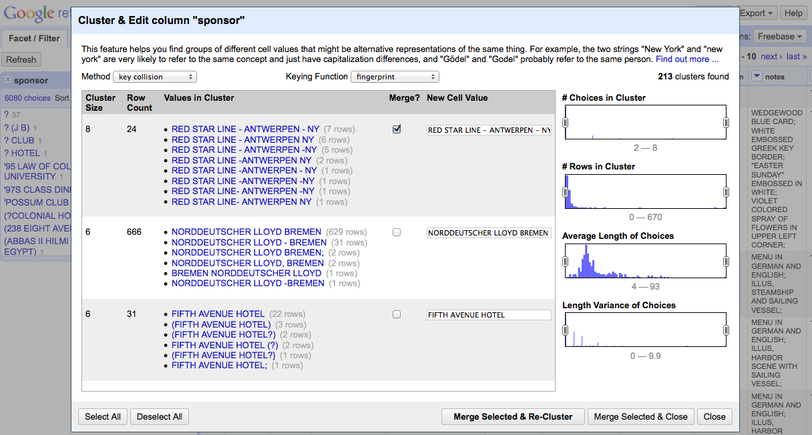
Faceting and Clustering
Notes:
-- For each cluster, review the values in the cluster, and (where needed) determine the preferred cell value.
-- Select the “Merge?” check box
-- Then select “Merge Selected and Re-Cluster”

Slide 27
What is clustering?
Key collision (fastest, safest)
Fingerprint, Ngram Fingerprint = defaults
Match normalized strings in different ways
Metaphone = English pronunciation
Nearest Neighbor
PPM = Partial matching
Levenshtein = edit distance

Slide 28
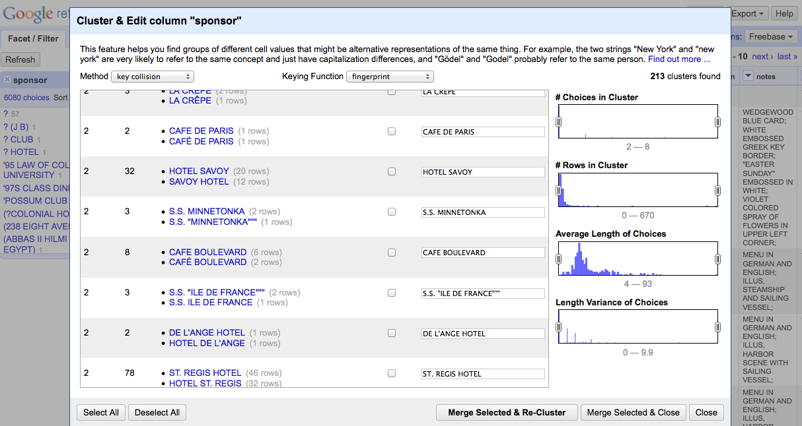
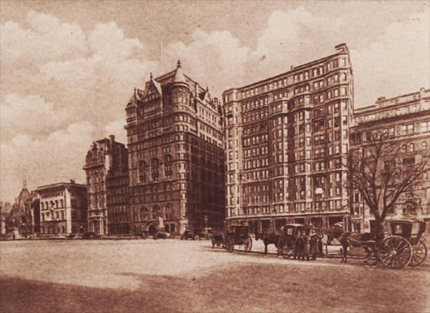
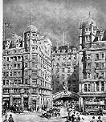
Check your clusters!
Hotel Savoy
59th St. & 5th Ave.
New York, New York
Savoy Hotel
Strand
London WC2R 0EU
United Kingdom
Notes:
Just because their names are similar doesn’t mean they’re the same!
-- Today the Hotel Savoy is an Apple Store. The Savoy Hotel is still in operation.

Slide 29
Walkthrough: Explore Open Refine
Using the NYPL dataset, try clustering and cleaning other columns
What transformations need to be made?
What clustering methods work best?
Try extracting your operations
Think about how you might create a protocol for cleaning datasets

Slide 30
II. Reconciliation & find & replace with GREL
For this example, we’ll use the “biodiversity.txt” dataset
Reconciliation = comparing and correcting data fields according to a master list
GREL = Google Refine Expression Language

Slide 31
Name Reconciliation
“a semi-automated process of matching text names to database IDs (keys). This is semi-automated because in some cases, machine alone is not sufficient and human judgment is essential.”
More resources for reconciliation:
https://github.com/OpenRefine/OpenRefine/wiki/Reconcilable-Data-Sources

Slide 32
Name Reconciliation
Used for:
Retroactively controlling a vocabulary
Linking to and pulling additional data from a larger data store
In biology: to correct species names
From Rod Page’s iPhylo Blog
http://iphylo.blogspot.com/2012/02/using-google-refine-and-taxonomic.html

Slide 33
“scientificName” > Reconcile > Start reconciling

Slide 34
Select “Add Namespaced Service
http://iphylo.org/~rpage/phyloinformatics/services/reconciliation_eol.php

Slide 35
EOL: http://iphylo.org/~rpage/phyloinformatics/services/reconciliation_eol.php
NCBI taxonomy: http://iphylo.org/~rpage/phyloinformatics/services/reconciliation_ncbi.php
uBio FindIT: http://iphylo.org/~rpage/phyloinformatics/services/reconciliation_ubio.php GBIF: http://iphylo.org/~rpage/phyloinformatics/services/reconciliation_gbif.php
Global Names Index:http://iphylo.org/~rpage/phyloinformatics/services/reconciliation_globalnames.php

Slide 36
Start Reconciling!

Slide 37
It might take a while…

Slide 38
Match each cell to best candidate

Slide 39
“scientificName” > Edit column > Add column based on this column

Slide 40
Expression: cell.recon.match.name

Slide 41
Done!
Notes:
Switch to live preview – talk about comparing different resources

Slide 42
Find and Replace in Open Refine
One of drawback with this program- some simpler things in Excel are a little more complicated here.
To find and replace, you need to write an expression in GREL (Google Refine Expression Language)

Slide 43
Walkthrough: find and replace with GREL
Click the triangle on the column you want to edit, select “Transform…”
Enter
replace(cell.value, “the text you want to replace in quotes", “the text you want to replace it with in quotes“)
into the "Expression" field -- your replaced text should show up in the preview-- and press "OK"

Slide 44
III. Open Refine for publishing XML-formatted metadata
Open Refine can export your data in a range of formats:

Slide 45
III. Open Refine for publishing XML-formatted metadata
Open Refine can export your data in a range of formats:
“Templating” option can be used to transforms tabular data into XML or JSON!

Slide 46
Walkthrough
Return to the biodiversity project in Open Refine
Go to “Export”, select “Templating
Note the default export is set to “JSONize” your data

Slide 47
Walkthrough
Open the “DwCtemplate.txt” file and paste each portion into the appropriate part of the template

Slide 49
Walkthough
Try adding more data into your template
Add a row for “county” under the Location block
Add a row for “catalogNumber” in the Occurrence block
What else?

Slide 50
Summary
Strengths:
Open source
Much more powerful than Excel (some functions easier to use)
Platform independent
Great history tracking (provenance!)
Can export commonly used functions for reuse (more provenance!)
Notes:
Don’t neglect to get to this point and slide
Think about adding some more discussion poitns

Slide 51
Summary
Weaknesses:
Can be a little unstable; some queries are slow
Relies on many external services – some (Freebase) no longer supported
Some methods require light programming
More advanced functions are possibly biased toward English/Western languages (unfortunately a common problem in text processing)

Slide 52
Further Resources
Main project page (You can download the program here): http://openrefine.org/
Github repository (This is where the source code lives): https://github.com/OpenRefine/OpenRefine
Open Refine Documentation (AKA an extensive user manual): https://github.com/OpenRefine/OpenRefine/wiki/Documentation-For-Users
Additional Reconciliation Services:
There are a bunch listed here — For those asking about reconciling to local data sources/spreadsheets, see Nomenklatura & Reconcile-csv: https://github.com/OpenRefine/OpenRefine/wiki/Reconcilable-Data-Sources
More on GREL: https://github.com/OpenRefine/OpenRefine/wiki/GREL-String-Functions

Slide 53
Acknowledgments
This NYPL portion of this exercise was created at the Maryland Institute for Technology in the Humanities and developed through the Digital Humanities Data Curation Institute series, generously funded by the National Endowment of the Humanities.
Special thanks to Trevor Muñoz, Lydia Zvyaginsteva and Megan Senseney!

Slide 54
Data Citation

Slide 55
Agenda
Why cite data?
Anatomy of a data citation
Implementing data citation initiatives
NCAR
IQSS @ Harvard
Tracking and tracing data citation

Slide 56
Why do we cite anything?
Paying homage
Giving credit
Identifying methodology
Background reading
Correcting own work
Correcting other’s work
Criticising previous work
Alerting re: forthcoming work
Providing leads
Authenticating data
Identifying the original paper
Arguing with others
Disputing the work of others
+more...
Garfield, E. (1996) When to cite. Library Quarterly, 66 (4): 449-458

Slide 57
Why do we cite data?
Paying homage
Giving credit
Identifying methodology
Background reading
Correcting own work
Correcting other’s work
Criticizing previous work
Alerting re: forthcoming work
Providing leads
Authenticating data
Identifying the original paper
Arguing with others
Disputing the work of others
+more...
Garfield, E. (1996) When to cite. Library Quarterly, 66 (4): 449-458

Slide 58
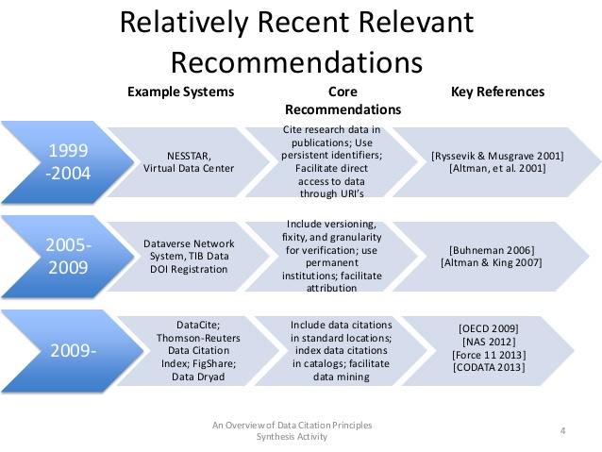
c/o Micah Altman http://www.slideshare.net/drmaltman/data-citationsynthesisteaser
Notes:
Relatively Recent Relevant Recommendations An Overview of Data Citation Principles Synthesis Activity 4 1999 -2004 NESSTAR, Virtual Data Center Cite research data in publications; Use persistent identifiers; Facilitate direct access to data through URI’s [Ryssevik & Musgrave 2001] [Altman, et al. 2001] 2005- 2009 Dataverse Network System, TIB Data DOI Registration Include versioning, fixity, and granularity for verification; use permanent institutions; facilitate attribution [Buhneman 2006] [Altman & King 2007] 2009- DataCite; Thomson-Reuters Data Citation Index; FigShare; Data Dryad Include data citations in standard locations; index data citations in catalogs; facilitate data mining [OECD 2009] [NAS 2012] [Force 11 2013] [CODATA 2013] Example Systems Core Recommendations Key References

Slide 59

Data Citation Principles

Slide 60
Working group goals:
Purpose, function and attributes of citations.
Find balance between human understandable and machine-actionable.
Not comprehensive recommendations for data stewardship.
Encourage communities to develop practices and tools that embody these principles.

Slide 61
Importance
Data should be considered legitimate, citable products of research. Data citations should be accorded the same importance in the scholarly record as citations of other research objects, such as publications.

Slide 62
Credit and Attribution
Data citations should facilitate giving scholarly credit and normative and legal attribution to all contributors to the data, recognizing that a single style or mechanism of attribution may not be applicable to all data

Slide 63

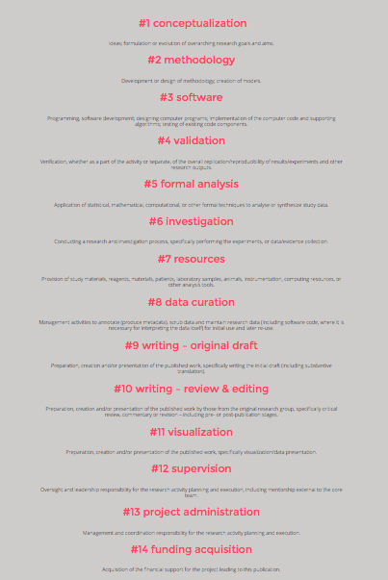

Slide 64
Evidence
In scholarly literature, whenever and wherever a claim relies upon data, the corresponding data should be cited.

Slide 65
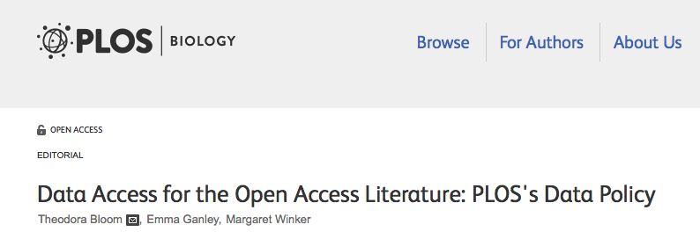
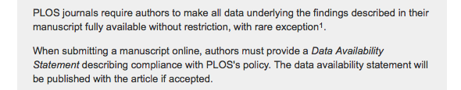
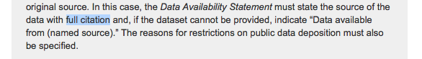
Notes:
Example from a recent policy change at the worlds third largest publisher …

Slide 66
Unique Identification
A data citation should include a persistent method for identification that is machine actionable, globally unique, and widely used by a community[4].

Slide 67
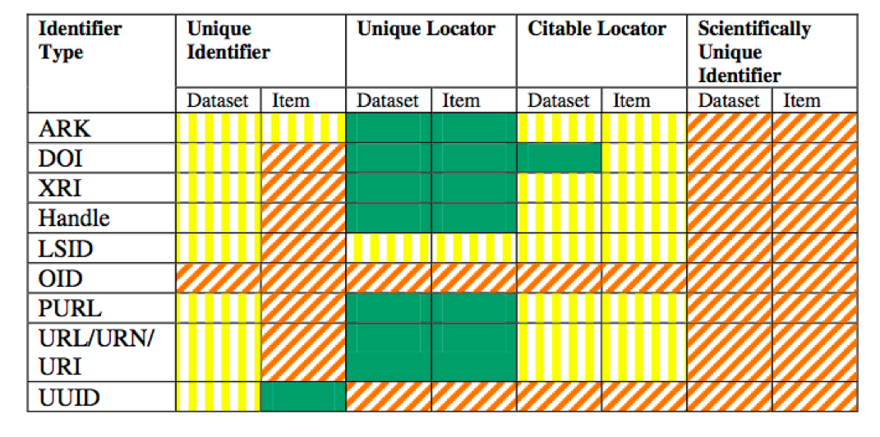
Notes:
The point is not that any one of these are right or wrong –but that they work for certain communities, and not for others… as we will see in our two case studies…

Slide 68
Access
Data citations should facilitate access to the data themselves and to such associated metadata, documentation, code, and other materials, as are necessary for both humans and machines to make informed use of the referenced data.

Slide 69
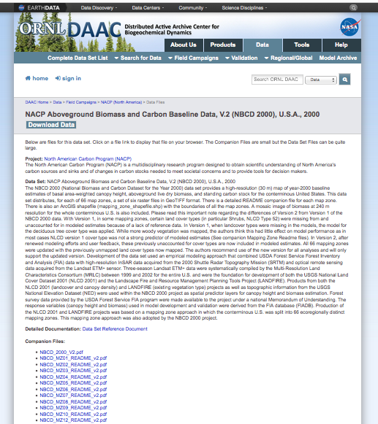
Where should the identifier resolve?
http://dx.doi.org/10.3334/
ORNLDAAC/1081

Slide 70
Persistence
Unique identifiers, and metadata describing the data, and its disposition, should persist -- even beyond the lifespan of the data they describe

Slide 71
Specificity and Verifiability
Data citations should facilitate identification of, access to, and verification of the specific data that support a claim. Citations or citation metadata should include information about provenance and fixity sufficient to facilitate verfiying that the specific timeslice, version and/or granular portion of data retrieved subsequently is the same as was originally cited

Slide 72
Interoperability and Flexibility
Data citation methods should be sufficiently flexible to accommodate the variant practices among communities, but should not differ so much that they compromise interoperability of data citation practices across communities

Slide 73
Brainstorm …
How are citations to data different than citations to bibliographic resources?
What are some problems in citing that should be remedied, and how might we solve them?

Slide 74
Problems in citing data
Authorship
Dynamic / Versioned resources (which data?)
Granularity – no chapter, page, or paragraph markings

Slide 75
Anatomy of a Data Citation
Could include any of the the following elements:
Author, publication date, publisher, resource type (database, dataset, image, etc.), location, identifier, version, edition, title, etc.
Ball, A. & Duke, M. (2012). ‘How to Cite Datasets and Link to Publications’. DCC How-to Guides. Edinburgh: Digital Curation Centre. Available online: http://www.dcc.ac.uk/resources/how-guides - See more at: http://www.dcc.ac.uk/resources/how-guides/cite-datasets#sthash.EY03YKRD.dpuf

Slide 76
Anatomy of a Data Citation:
Earth Science Informatics Partners (ESIP) recommendation:
Zwally, H.J., R. Schutz, C. Bentley, J. Bufton, T. Herring, J. Minster, J. Spinhirne, and R. Thomas. 2003. GLAS/ICESat L1A Global Altimetry Data V018, 15 October to 18 November 2003. National Snow and Ice Data Center. dataset accessed 2011-07-21 at doi:10.3334/NSIDC/gla01.

Slide 77
Anatomy of a Data Citation:

Slide 78
Anatomy of a Data Citation
APA Cool, H. E. M., & Bell, M. (2011). Excavations at St Peter’s Church, Barton-upon-Humber [Data set]. doi:10.5284/1000389
Chicago (notes) 2. H. E. M. Cool and Mark Bell, Excavations at St Peter’s Church, Barton-upon-Humber (accessed May 1, 2011), doi:10.5284/1000389.
Cool, H. E. M., and Mark Bell. Excavations at St Peter’s Church, Barton-upon-Humber (accessed May 1, 2011). doi:10.5284/1000389.
MLA Cool, H. E. M., and Mark Bell. “Excavations at St Peter’s Church, Barton-upon-Humber.” Archaeology Data Service, 2001. Web. 1 May 2011. <http://dx.doi.org/10.5284/1000389>.
Oxford Cool, H. E. M. & Bell, M. (2011) Excavations at St Peter’s Church, Barton-upon-Humber [data-set]. York: Archaeology Data Service [distributor] <DOI 10.5284/1000389>.
See more at: http://www.dcc.ac.uk/resources/how-guides/cite-datasets#x1-13000
Notes:
Humanities and Social Science standards.

Slide 79
Data Citation Infrastructure
Step 1: Archived data
Step 2: Landing Page
Step 3: Persistent Identifier
Step 4: Clear metadata
Step 5: Advertisement (cite our data like this…)
Notes:
Can be achieved in many ways…

Slide 80
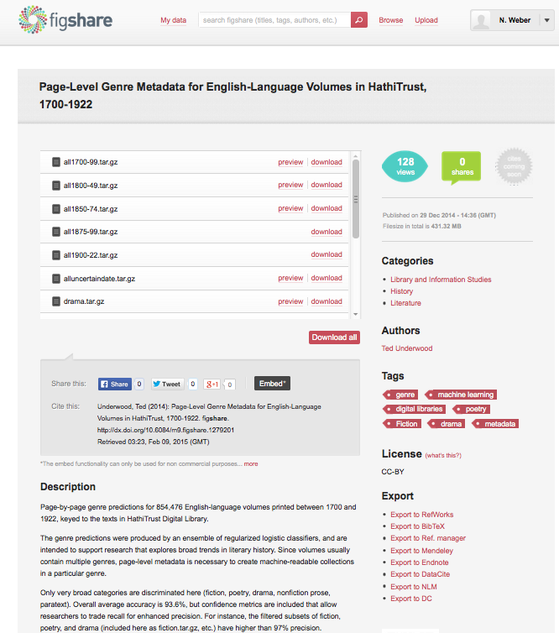
Step 1 (data archived on FigShare)
Step 2 (Creates landing Page)
Step 3: Persistent Identifier (DOI)
Step 4: Clear metadata (?)
Step 5: Advertise (!)
Notes:
DIY aporoach

Slide 81
Data Citation Infrastructure
Step 1: Archived data
Step 2: Landing Page
Step 3: Persistent Identifier
Step 4: Clear metadata
Step 5: Advertisement (cite our data like this…)
Notes:
Can be achieved in many ways…

Slide 82
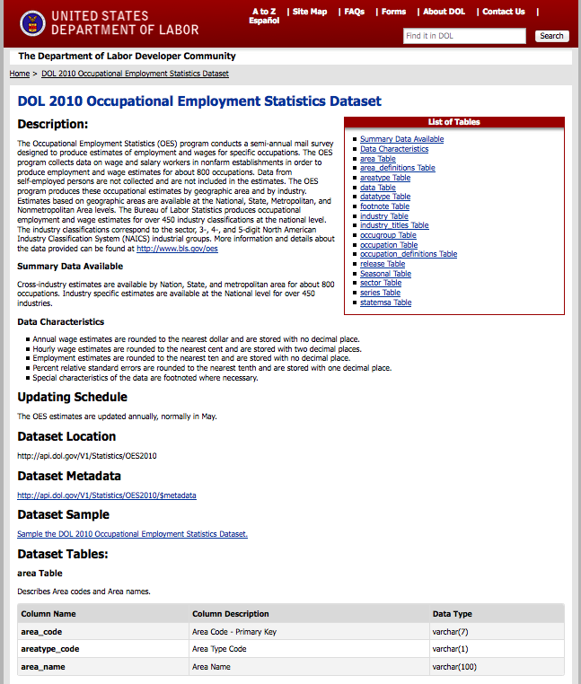
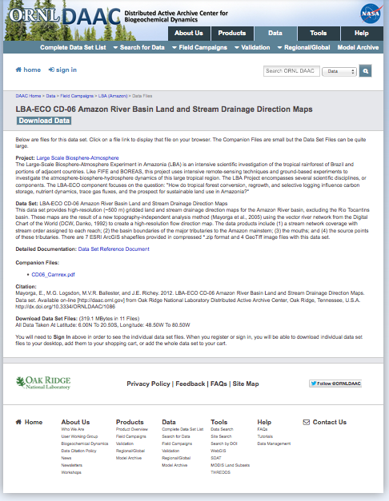
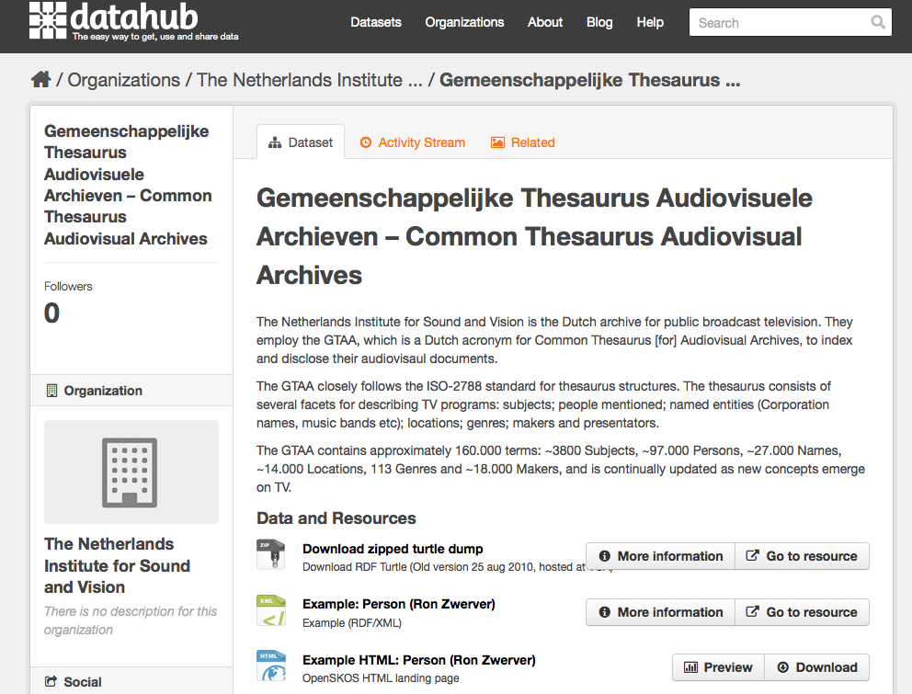
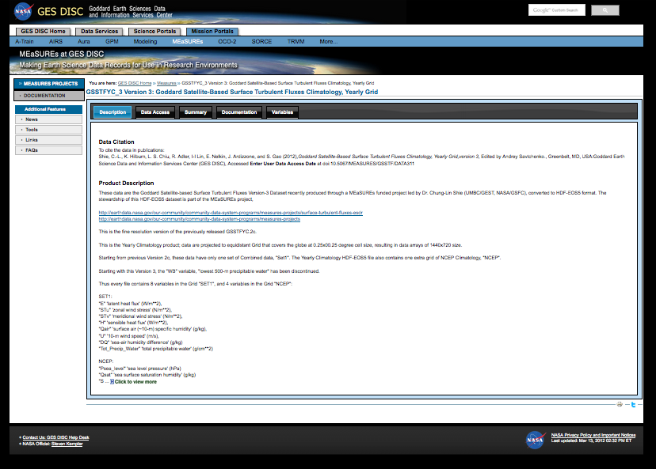

Slide 83

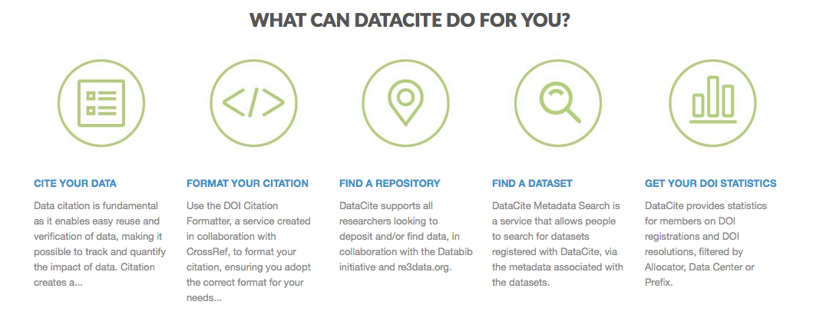
Notes:
Setting up data services… Roll your own…

Slide 84
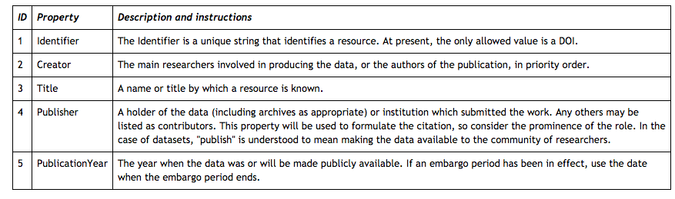

Slide 85
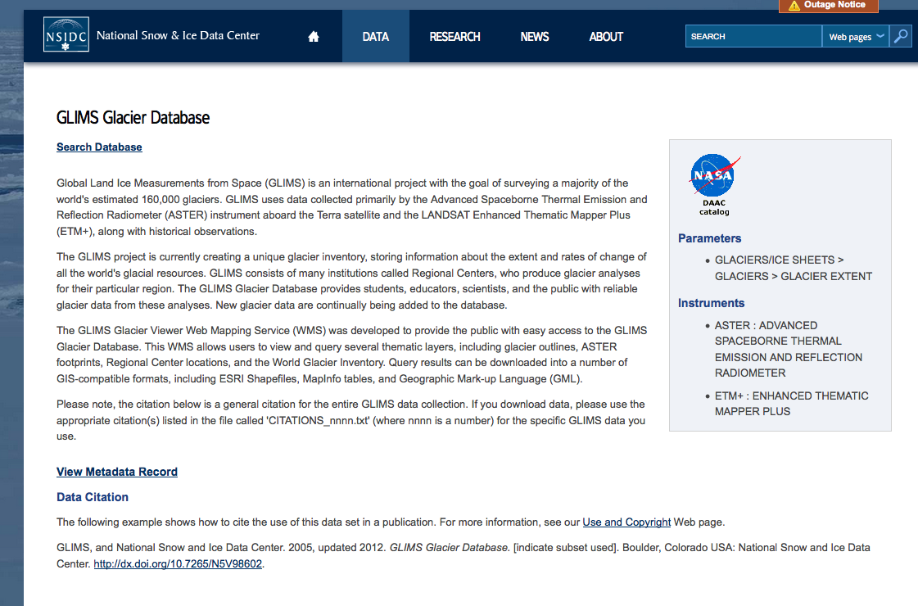

Slide 86
Some Open Issues

Slide 87
Data Citation in the Humanities?
What kind of data?
• digitized editions of major works;
• transcriptions of manuscripts;
• thematic collections (e.g., author, period, genre);
• language corpora (balanced or opportunistic; monolingual or multilingual [parallel structure or parallel-text translation equivalents]);
• images of artworks (e.g., Rossetti, Blake, DeYoung Museum ImageBase); and
• maps.
http://www.nap.edu/openbook.php?record_id=13564&page=59

Slide 88
Major issues in DH citation…
“When a data resource is tightly coupled with a particular piece of software, it can be difficult to distinguish the one from the other, with consequent difficulties for anyone who would like to cite the data resource itself, and not the data-plus-software combination.”
Michael Sperberg-McQueen

Slide 89
More issues… (also from MSM)
Copyright - “we ran a stylometric analysis on a corpus which has these properties, but we cannot let you see the actual corpus because we did not obtain the copyright.”
Anti-scientism – DH data are different, and not subject to same conventions (naive interp.)
Quiddity - Large humanities projects typically make multiple passes over material. reading text; text-critical variorum text; text with literary annotations; linguistic annotations (glosses for cruxes? parse trees? …); or formalization of propositional content.

Slide 90
Significant Identities
ORCID ID – people
Accession numbers – data
PIs – resource landing page
Versions
Institutions
Titles

Slide 91
Dynamic Data Citation
“…query centric approach”
utilize query languages to construct arbitrary subsets
data is maintained with version over time
the queries can be use to access the same data set again
Proll, S., & Rauber, A. (2013, October). Scalable data citation in dynamic, large databases: Model and reference implementation. In Big Data, 2013 IEEE International Conference on (pp. 307-312). IEEE.
Notes:
Very much an open issue…

Slide 92

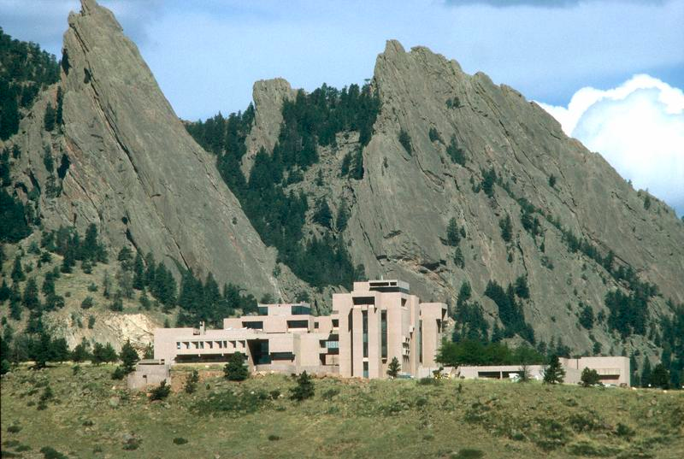
Example 1

Slide 93
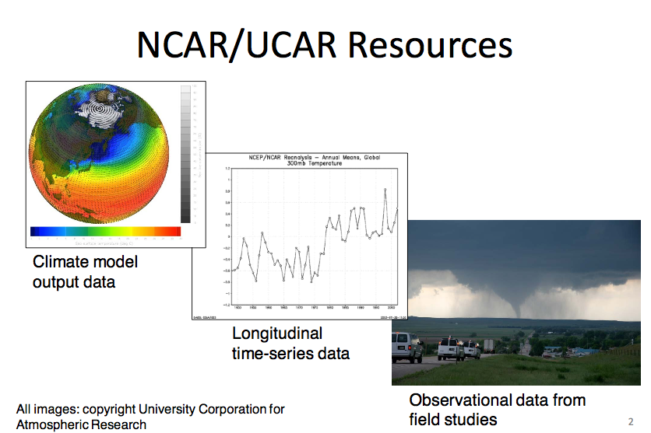

Slide 94
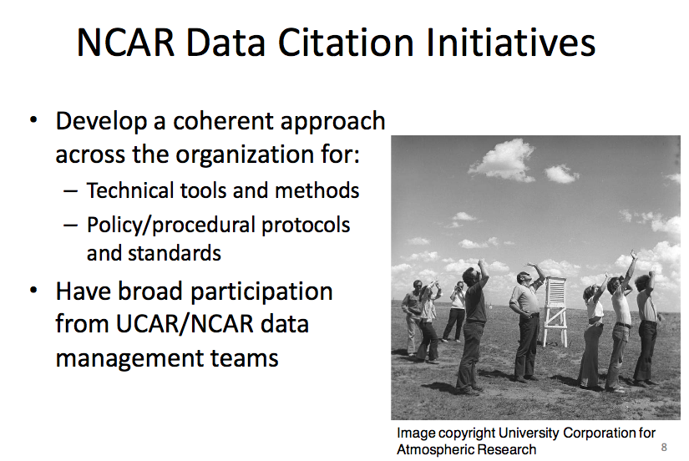

Slide 95
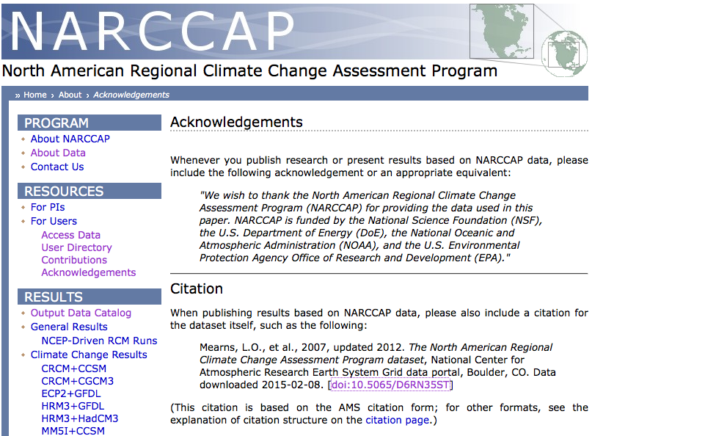

Slide 96
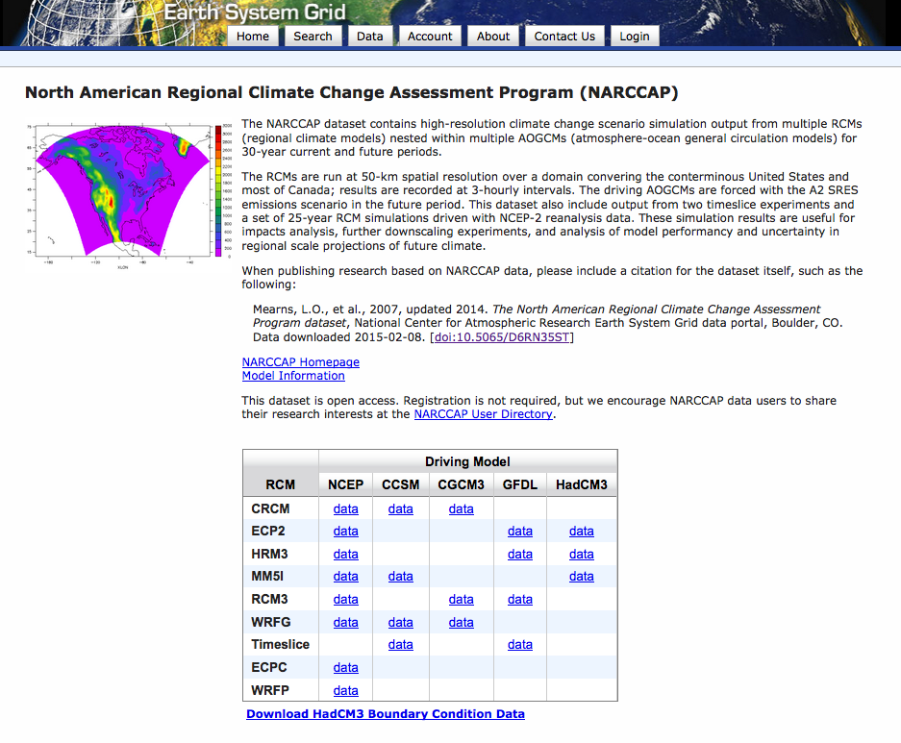
Notes:
Landing page..

Slide 97
Data archives
– Who should be assigning identifiers
– How to assign identifiers to resources
– How to register identifier metadata
– How to ensure that identifiers will be maintained
– How to provide recommended citations to users
Outreach to users
–Make citation information easy to find/use
–Proactively inform users about citations and identifiers

Slide 98
NCAR – Use of DOIs
…use completely randomly generated DOIs for the reasons that
any organizational-specific components would become out of date if data are moved between archives or organizations and
2) any intelligence built into a DOI is another thing that needs to be managed and maintained over the long term.
Down side: human-readability, consolidation with internal ID schemes, and easier Google searching for groups of IDs.

Slide 99

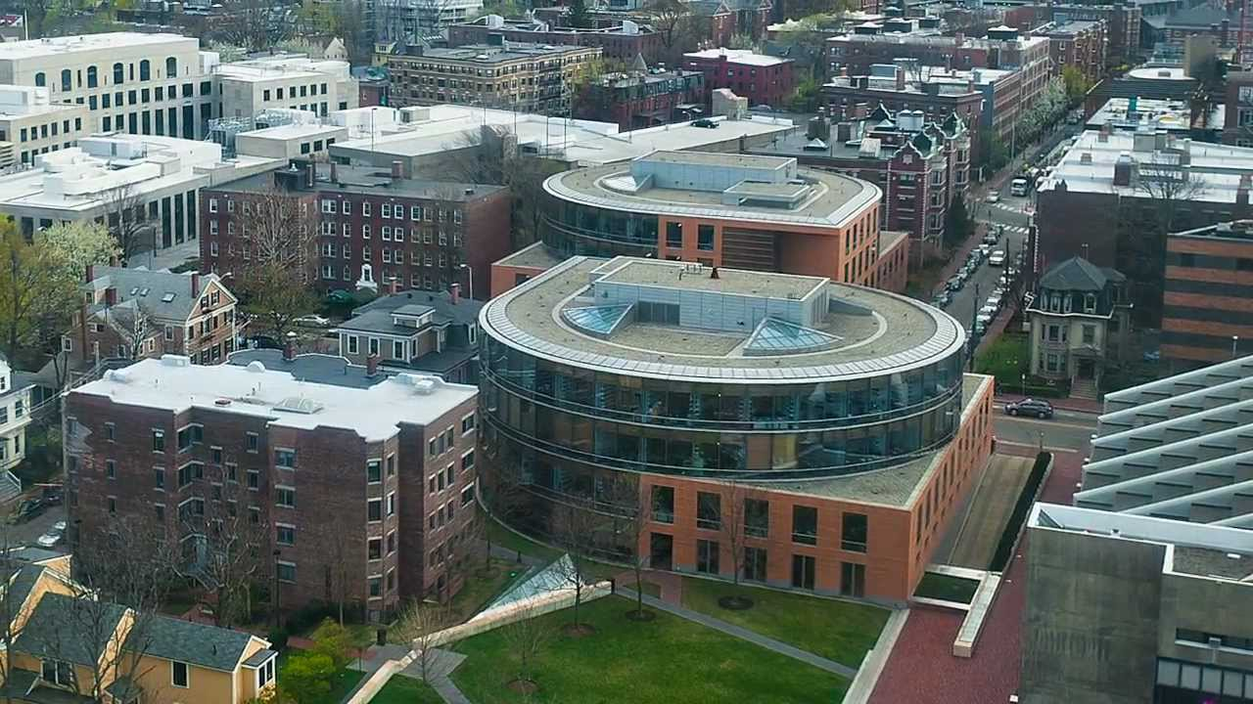
Example 2

Slide 100
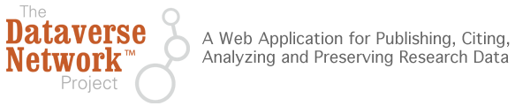
…develops software, protocols, and community connections for creating research data repositories that automate professional archival practices, guarantee long term preservation, and enable researchers to share, retain control of, and receive web visibility and formal academic citations for their data contributions.

Slide 101
Example Citations…
From International Studies Quarterly, King and Zeng, 2007, p. 209:
- Gary King; Langche Zeng, 2006, "Replication Data Set for 'When Can History be Our Guide? The Pitfalls of Counterfactual Inference'" hdl:1902.1/DXRXCFAWPK UNF:3:DaYlT6QSX9r0D50ye+tXpA== Murray Research Archive [distributor]
From Political Analysis, Hanmer, Banks, and White, 2013:
- Hanmer, Michael J.; Banks, Antoine J., White, Ismail K., 2013, "Replication data for: Experiments to Reduce the Over-reporting of Voting: A Pipeline to the Truth", http://dx.doi.org/10.7910/DVN/22893 UNF:5:eJOVAjDU0E0jzSQ2bRCg9g== IQSS Dataverse Network [Distributor]
Notes:
Examples of data cited in dataverse holdings…

Slide 102
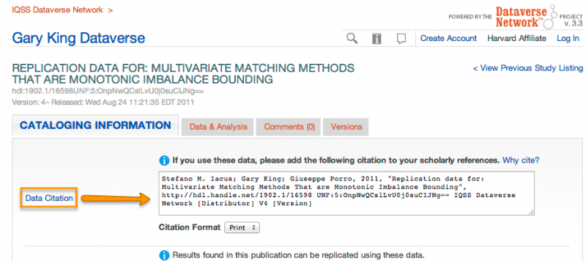
DataVerse: Citation Baked-In

